Slide 1
Applied Distributed Systems CSCI B649
Authors: Vikrant Deshpande, Shubham Mohapatra, Rutuja Jadhav
INDIANA UNIVERSITY

Slide 2
Introduction

Slide 3
Introduction
Our goals were:
Understand distributed architecture components, message queues, testing and deployment strategies, CICD, etc.
Build a full-stack weather analysis system that’s highly available and fault-tolerant, architected in 3 milestones.
Deploy and review an open-source project under the Apache foundation.

Slide 4
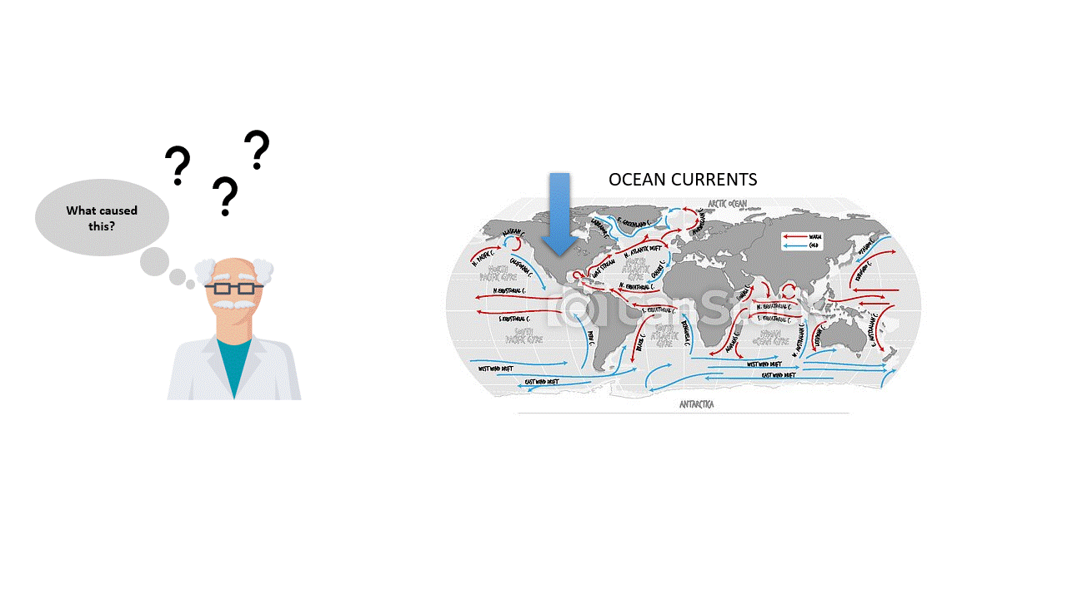
Introduction
Elevator Pitch:
Research scientists will understand how weather phenomena in a region, affect their research.
Features to view (Data Source):
Reflectivity (NEXRAD)
Spectrum width (NEXRAD)
Radial Velocity (NEXRAD)
ALBEDO (MERRA)
LWGNTICE (MERRA)

Slide 5
Experimental Testbed
Project 1

Slide 6
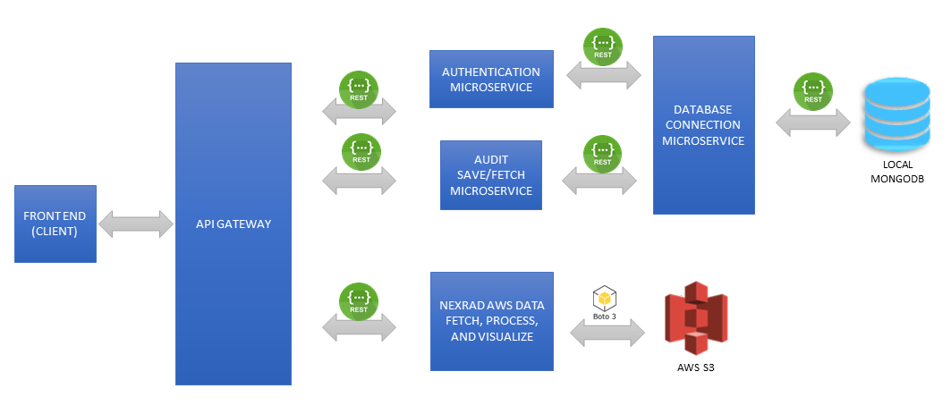
Experimental Testbed Project 1
Architecture Decisions:
6 microservices
Interservice communication in REST
Gateway handles traffic routing
User creds and audit trail in MongoDB
Single service interacts with MongoDB
Single service for NEXRAD data on S3
Circle-CI for continuous integration

Slide 7
Experimental Testbed
Project 2

Slide 8
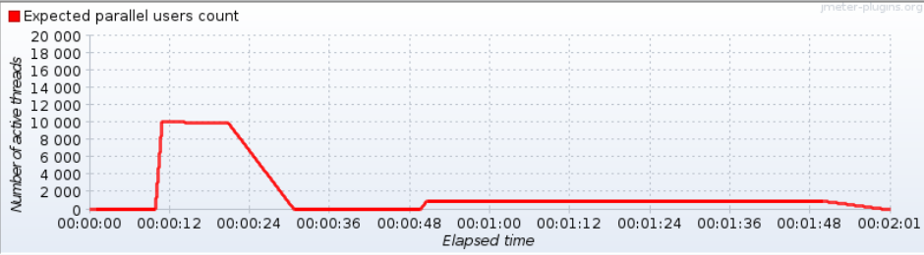
Experimental Testbed Project 2
Performance Testing:
Assess the system's maximum operating capacity.
Baseline 3 worker nodes of 16GB each assigned on Jetstream.
1, 3, 5 replica-pods spawned for each microservice using kubeadm.
Used Jmeter for both Load testing, and Spike testing.

Slide 9
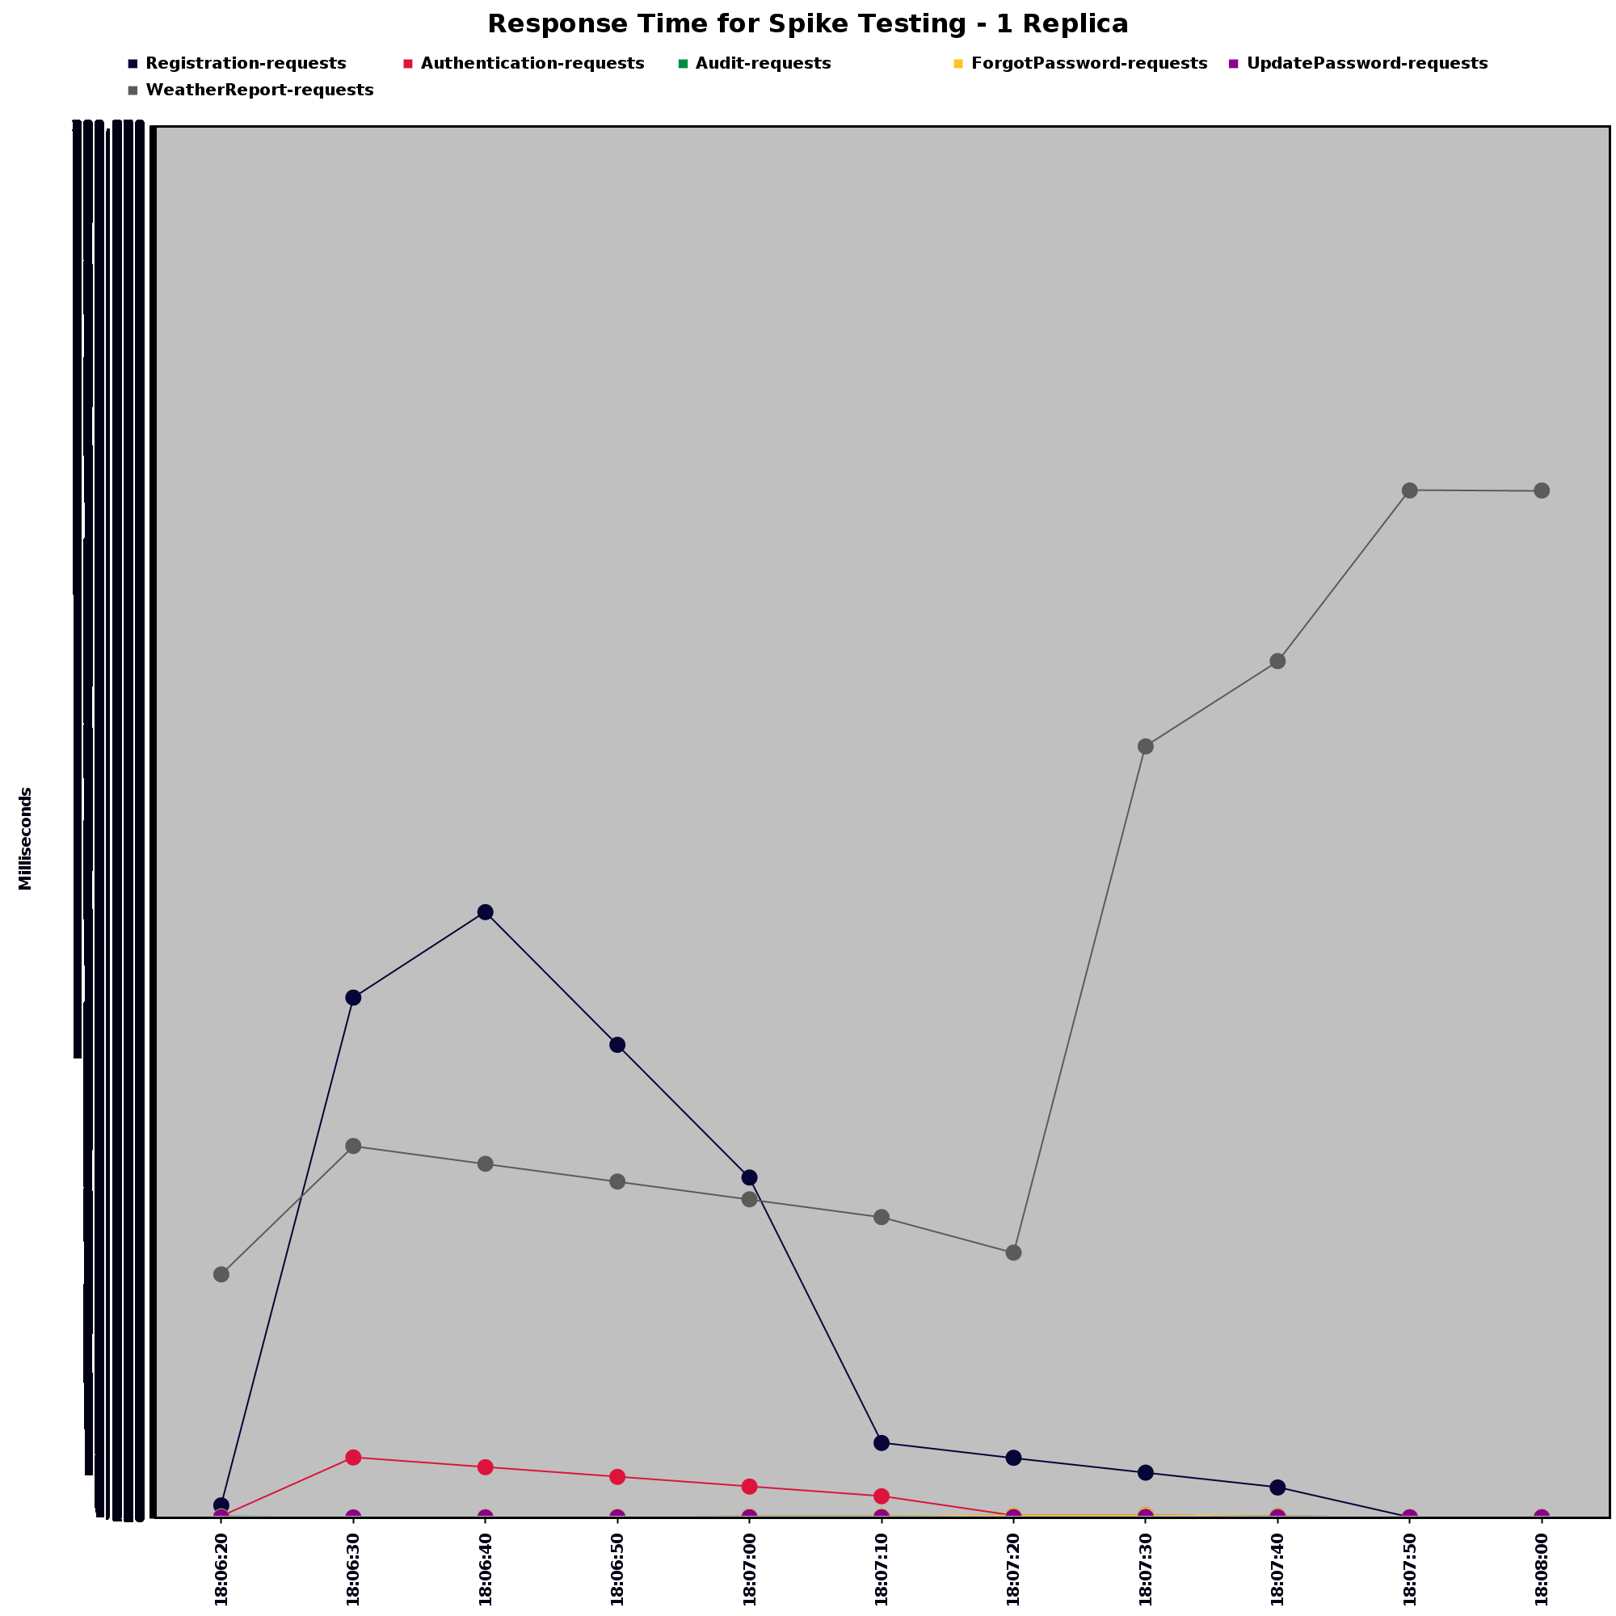
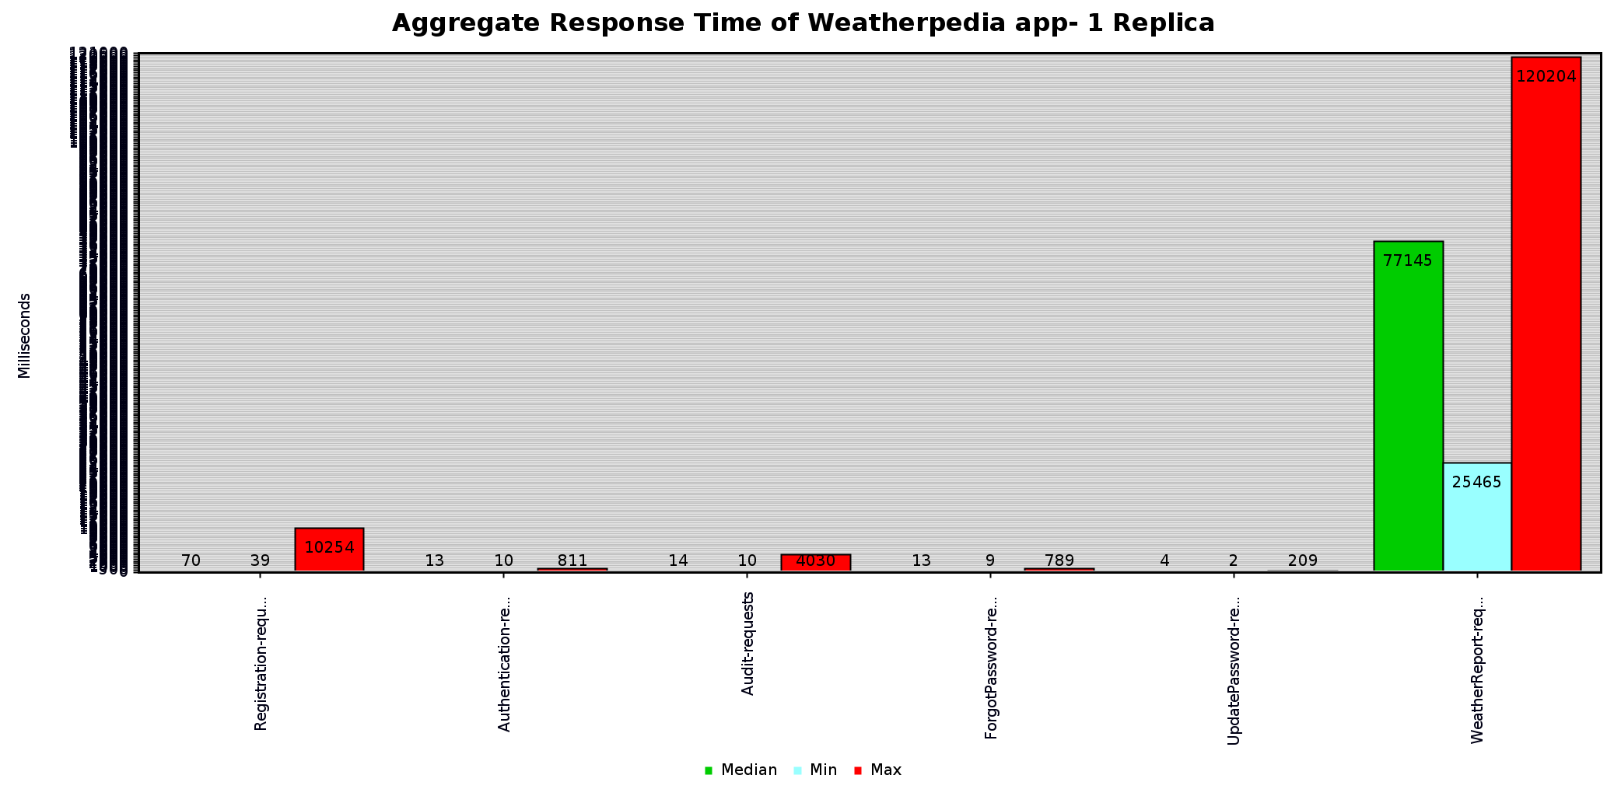
Experimental Testbed Project 2
Performance under constant load
Performance under sudden load

Slide 10
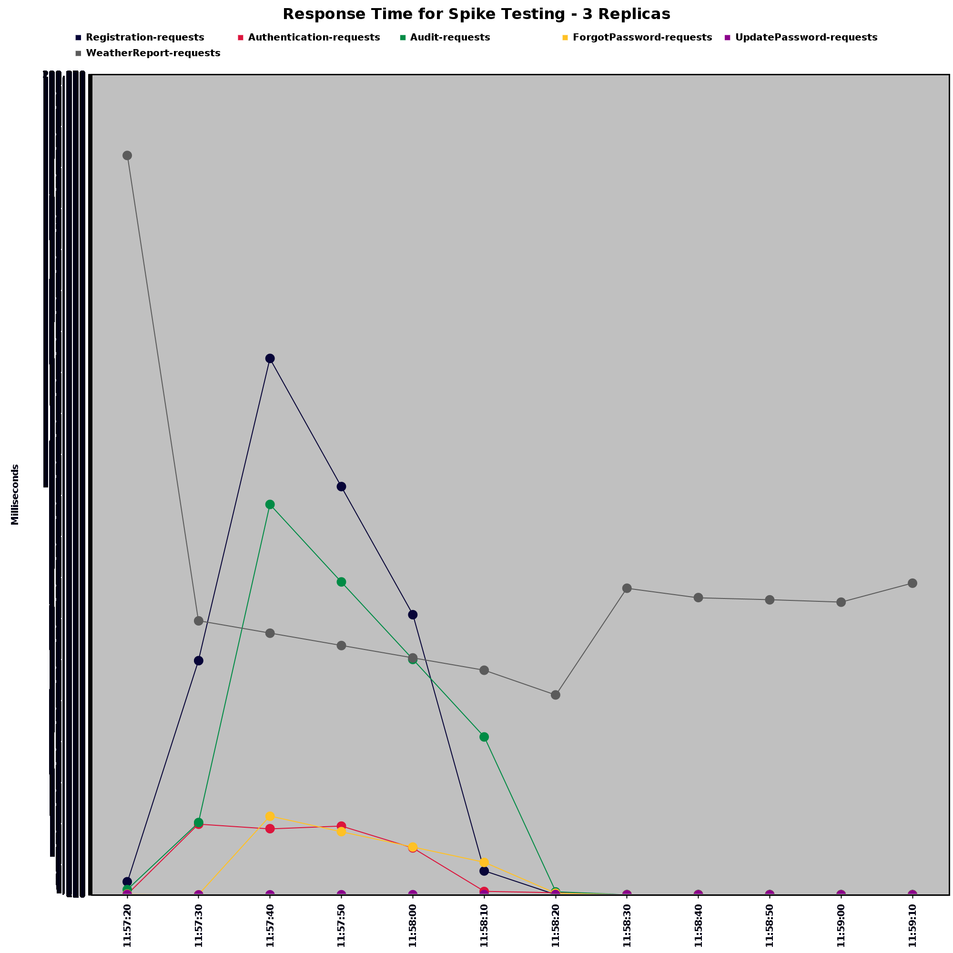
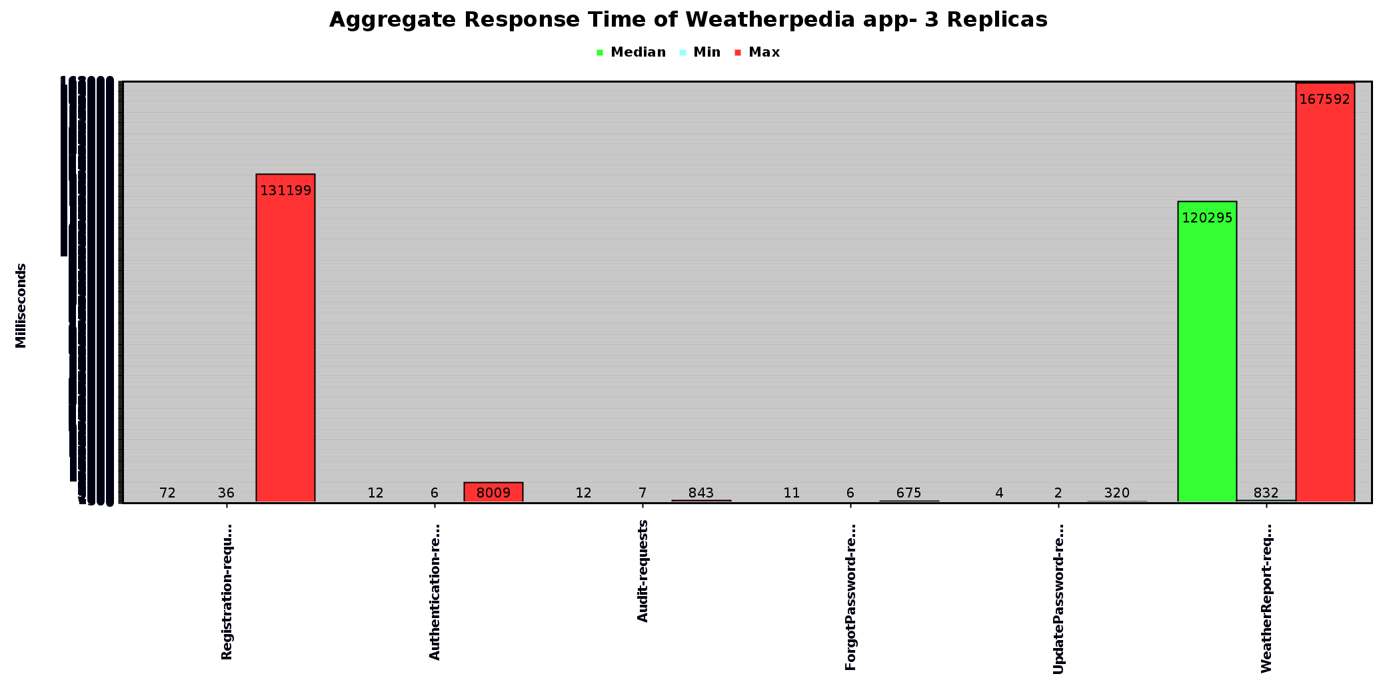
Experimental Testbed Project 2
Performance under constant load
Performance under sudden load

Slide 11
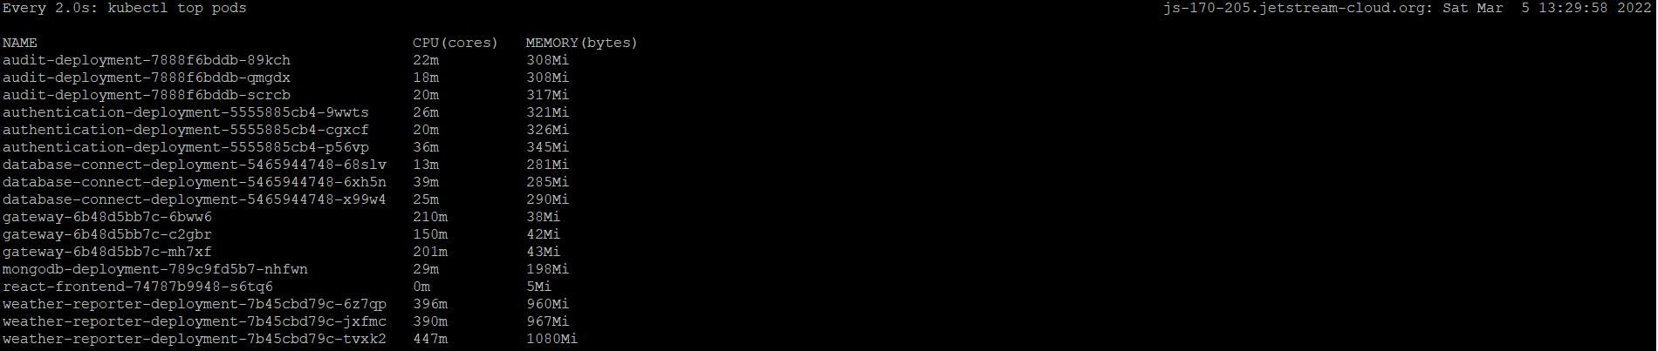
Experimental Testbed Project 2
Load Balancing in action

Slide 12
Experimental Testbed
Project 3

Slide 13
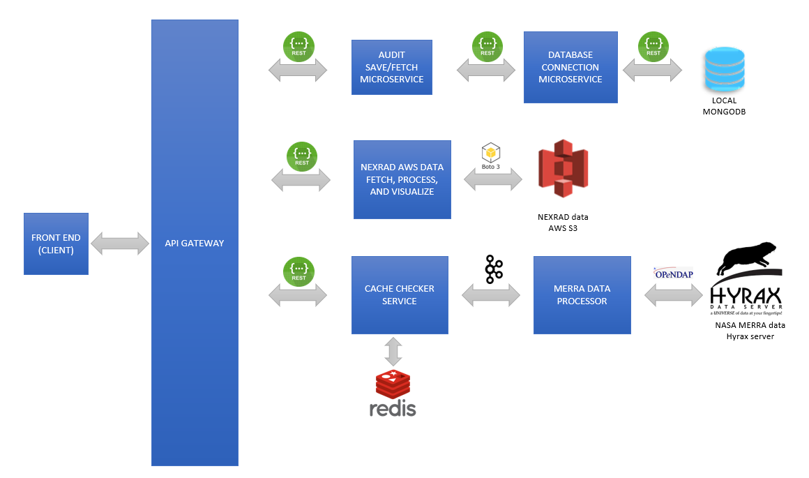
Experimental Testbed Project 3
Architecture Evolution:
7 microservices
OAUTH for session management
Kafka to stream MERRA data report
Caching of reports in Redis
User creds and audit trail in MongoDB
Circle-CI for entire CICD

Slide 14
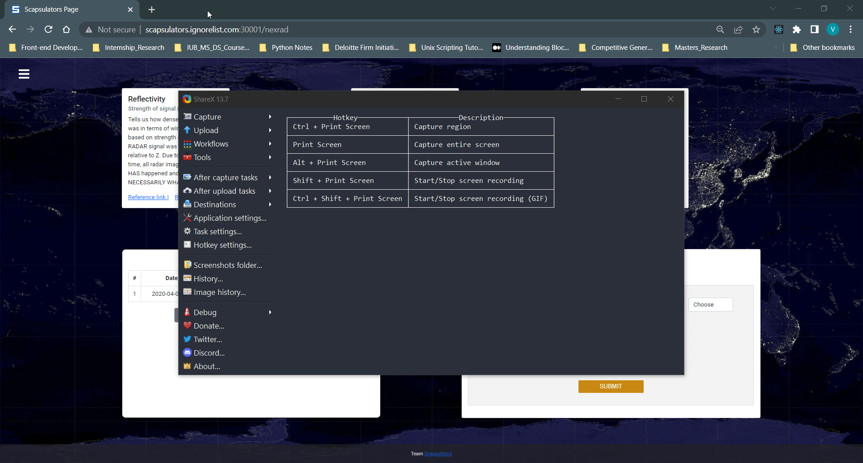
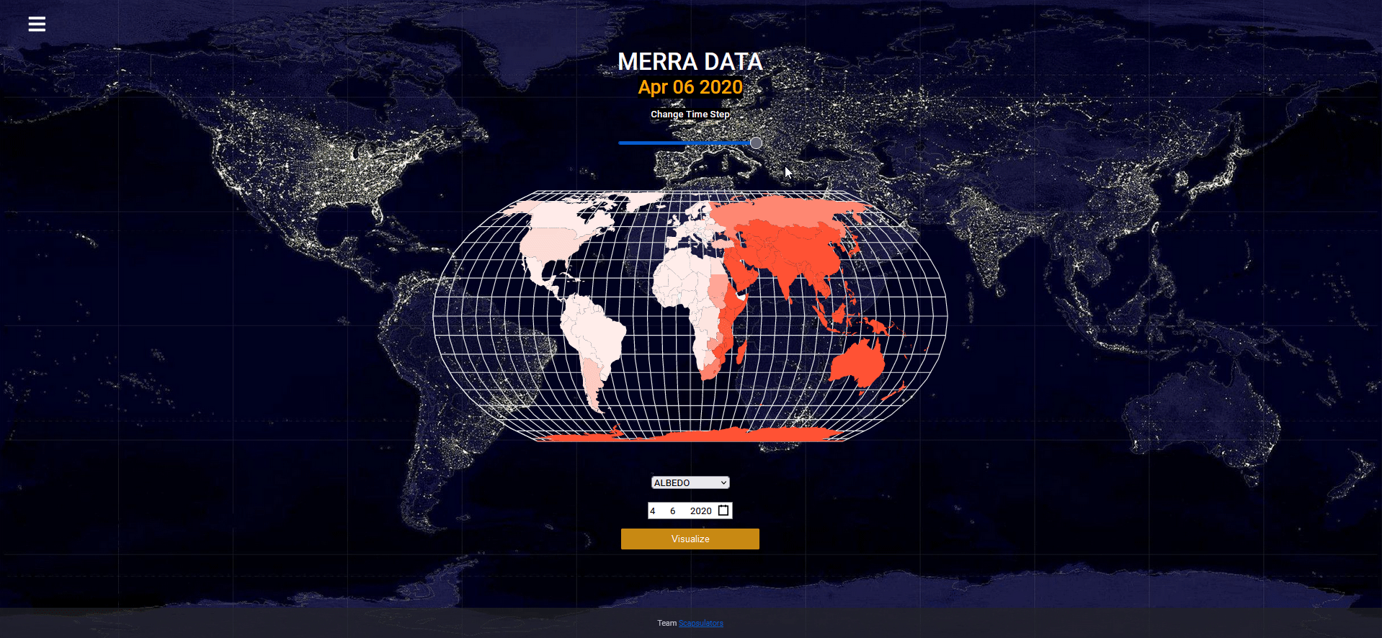
Experimental Testbed Demo
Demonstration
http://scapsulators.ignorelist.com:30001/

Slide 15
Case Study: Custos
Project 4

Slide 16
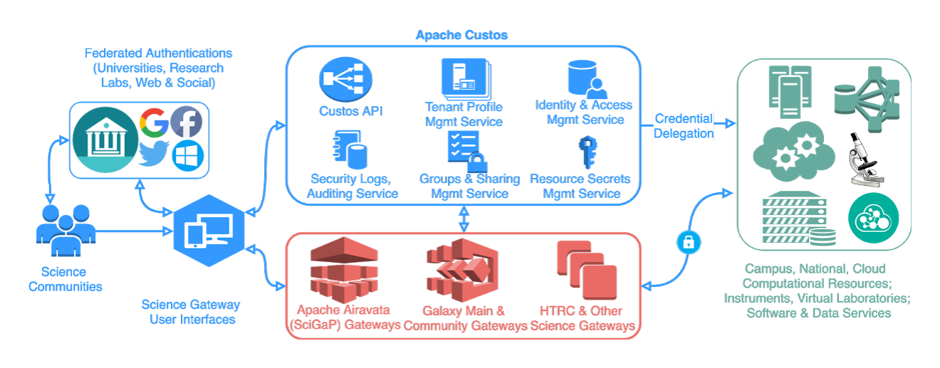
Case Study: Custos Project 4

Slide 17
Case Study: Custos Project 4
Open Issues identified and criticisms:

Slide 18
Thank You! ☺

